Slide 1
Database Engineering
Presented by:
Divya Hari Kumar
https://github.com/divziv
https://www.linkedin.com/in/divyaharikumar/

Slide 2

Table of Contents
Artificial Intelligence
Vector Databases
Open Source Databases
Information Retrieval
NoSQL
MongoDB
Conclusion

Slide 3
ARTIFICIAL INTELLIGENCE

Slide 4

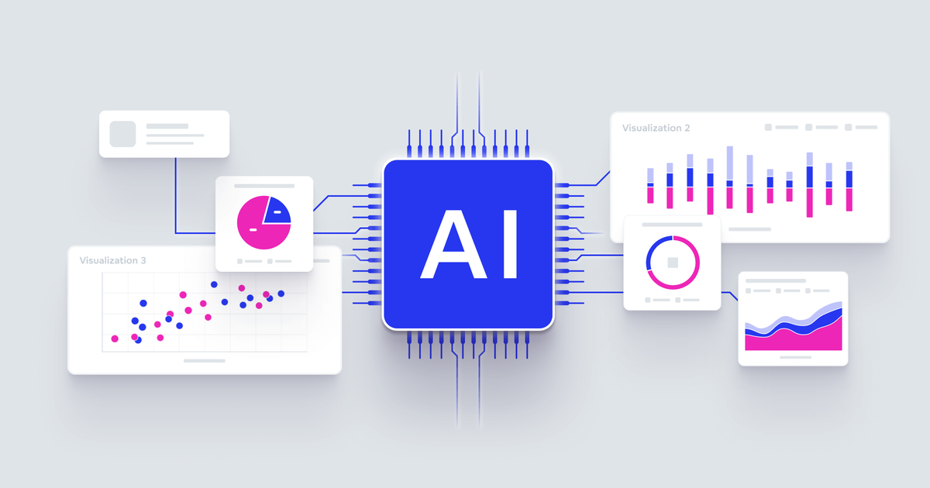
AI & Data
AI's Transformative Impact:
Revolutionizing industries.
Examples: Healthcare, finance, transportation, entertainment.
The Data-Driven Nature of AI:
Heavily rely on data.
More data often leads to better AI performance.
Diverse Data Types in AI:
AI works with various data forms.
Examples:
Structured data (tables, databases).
Unstructured data (text, images, audio, video).
Time-series data (sensor readings, financial data).
The Crucial Role of Vector Embeddings:
Essential for modern AI.
Represent data in a way that captures semantic meaning.
Enable similarity search and other AI tasks.
The Database Challenge:
Effectively managing diverse data.
Choosing the right database(impacts AI application performance).

Slide 5
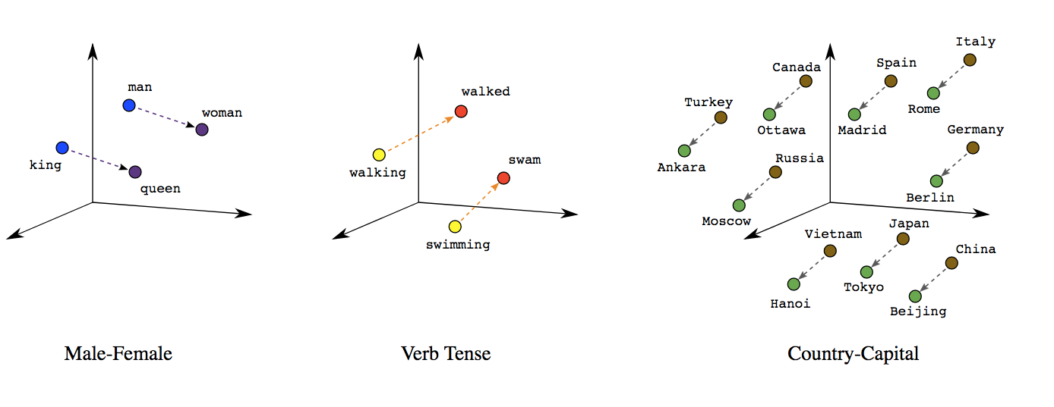
Vector Embeddings
X-axis: Country
Y-axis: Capital City
X axis: Gender (or Social Role)
Y axis: Power/Authority
X axis: Tense (or Grammatical Aspect)
Y axis: Semantic Similarity (or Verb Root)
What are Vector Embeddings?
Numerical representations of data.
Capture semantic meaning.
Enable AI to understand relationships between data.
Multi-Dimensional Vector Space:
Embeddings exist in a multi-dimensional space.
Similar data points are located closer together.
Generating Vector Embeddings:
Use machine learning models.
Examples:
Sentence Transformers (text)
CLIP (images and text)
Specialized models (audio, video, etc.)
The Training Process: Models are trained on large datasets. Learn underlying patterns and relationships. | Output: The model outputs a vector. This vector represents the input data. Preserves semantic similarity.

Slide 6
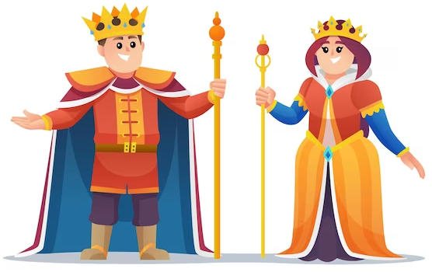


Word Embeddings Example
King and Queen
King and Apple
"King" and "Queen" would likely cluster together on the Power/Authority axis, indicating their similar roles within a monarchy.
"King" belongs to the semantic category of "royalty" or "human beings," while "apple" belongs to the category of "fruits" or "objects."

Slide 7
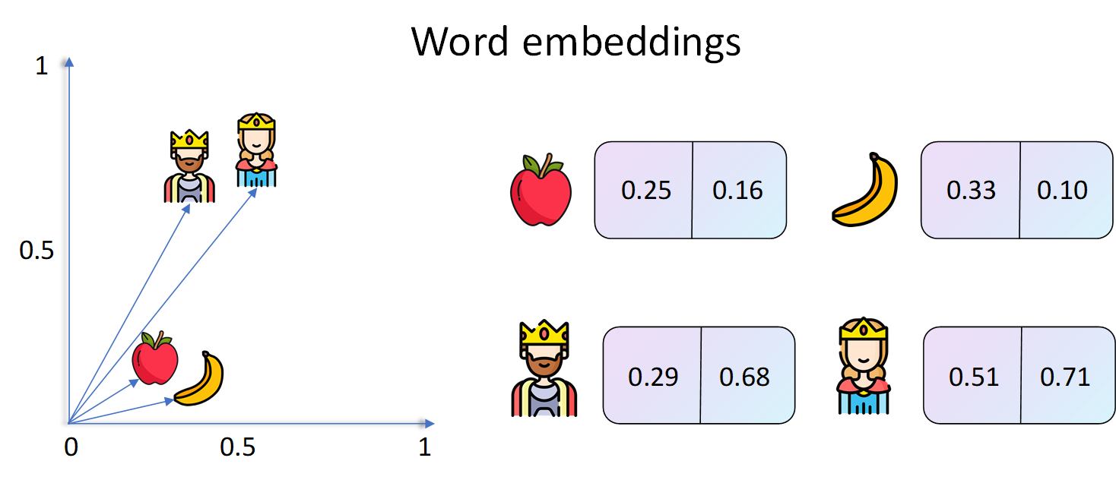

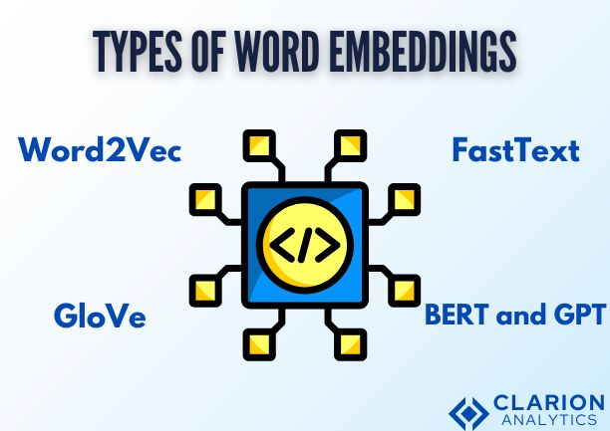

Slide 8
VECTOR
DATABASES

Slide 9
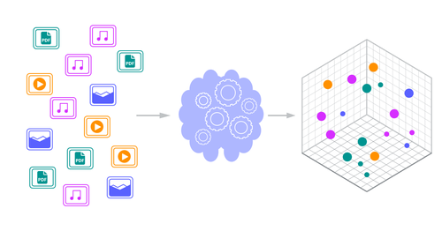
Vector Database
specialized type of database system
designed to efficiently:
store,
manage, and
query
vector embeddings.
Unlocking the Power of AI with Vector Databases
Efficiently storing and searching data based on similarity

Slide 10
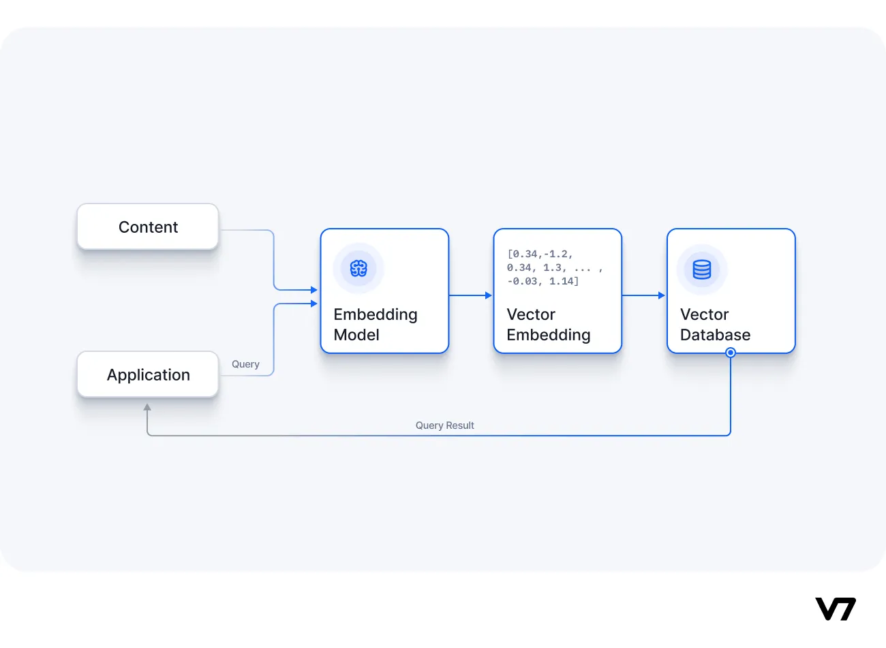
Core Functionalities
Similarity Search
Given a query vector (representing something like a product, image, text, etc.), find the other vectors in the database that are most similar to it.
"Similarity" is often measured by distance in the vector space (e.g., Euclidean distance, cosine similarity).
Objective:
Efficiently retrieve the top-k most similar vectors from a potentially massive dataset.
Essential for many AI applications:
Recommendation Systems: Finding items similar to user preferences.
Image Search: Finding visually similar images.
Semantic Search: Finding documents with similar meaning.
Similarity Search
Low Latency
Find the most similar vectors to a given query vector
Provide fast response times for real-time applications.
Efficient Indexing
High Throughput
Process a large number of queries concurrently.
Utilize optimized data structures for fast similarity searches
Scalability
Data Management
Handle massive datasets and high query volumes effectively.
Support operations like data ingestion, updates, deletions, and backups.

Slide 11
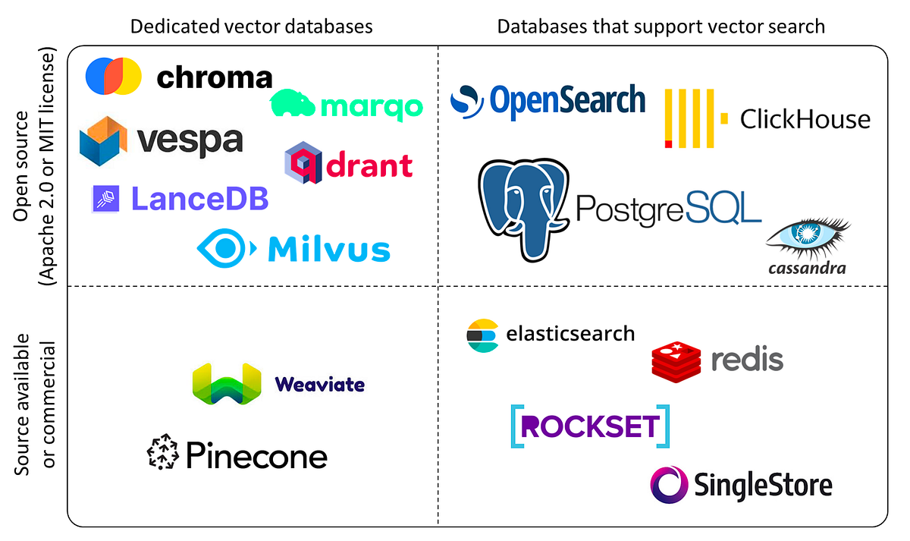
Popular Vector Databases
Pinecone
Chroma
Cloud-native
Fully managed VDB
Ease of use
Scalability
1
4
Python-first
Ease of use
integration with Python projects
Weaviate
Qdrant
VDB + knowledge graph Vector-based and Schema-based querying
2
5
High-performance VDB
Hybrid search (vector search with filtering on metadata)
Milvus
Faiss
High-performance
Scalability
Efficiency
3
6
A library
(not a standalone database) Provides efficient algorithms:
Similarity search
Clustering of dense vectors

Slide 12
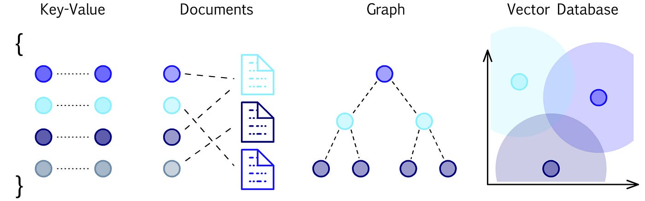
Packages used in Vector Databases
Vector Database Libraries:
Faiss (Facebook AI Similarity Search)
Annoy (Approximate Nearest Neighbors Oh Yeah)
NMSLIB (Non-Metric Space Library)
Embedding Generation Libraries:
Sentence Transformers
Hugging Face Transformers)
CLIP (Contrastive Language-Image Pre-training)
General-Purpose Libraries:
NumPy
SciPy

Slide 13
Vector Database Libraries
A library of algorithms for efficient similarity search and clustering of dense vectors.
A fast, approximate nearest neighbors library that provides efficient search in high-dimensional spaces.
A library for efficient similarity search in general metric spaces, including Euclidean distance and cosine similarity.
Faiss (Facebook AI Similarity Search)
Annoy (Approximate Nearest Neighbors Oh Yeah)
NMSLIB (Non-Metric Space Library)

Slide 14
Embedding Generation Libraries
A library for sentence, paragraph, and document embeddings.
A popular library for a wide range of transformer models, including those used for generating text embeddings (e.g., BERT, GPT).
A model for learning visual concepts from natural language supervision.
Sentence Transformers
Hugging Face Transformers
CLIP (Contrastive Language-Image Pre-training)

Slide 15
General-Purpose Libraries
Fundamental package for scientific computing in Python, used for array operations and linear algebra.
A library for scientific and technical computing, providing functions for optimization, integration, and linear algebra.
NumPy
SciPy

Slide 16

Indexing
Why Indexing is Essential?
Crucial for enabling fast and efficient similarity searches
Traditional databases - index on exact matches
Vector databases - index on the proximity of vectors in high-dimensional space
Speeding Up Searches:
Without indexing, finding the nearest neighbors to a query vector would require comparing it to every vector in the database, which is computationally expensive and slow, especially for large datasets.
Scalability:
Indexing allows vector databases to scale to handle massive datasets without sacrificing performance.
Real-Time Applications:
Indexing is vital for real-time applications that require low-latency responses.

Slide 17
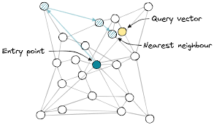
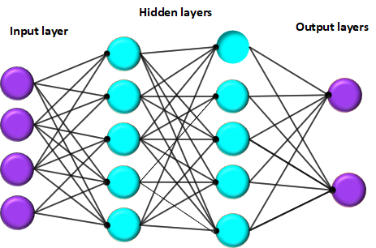
Types of Indexing Techniques
Primarily uses Approximate Nearest Neighbor (ANN) search algorithms
Trade off a small degree of accuracy for a significant speed improvement
Some techniques include:
Hierarchical Navigable Small World (HNSW)
Local Sensitive Hashing (LSH)
Inverted File System (IVF)
Product Quantization (PQ)
Tree-Based Indexes

Slide 18
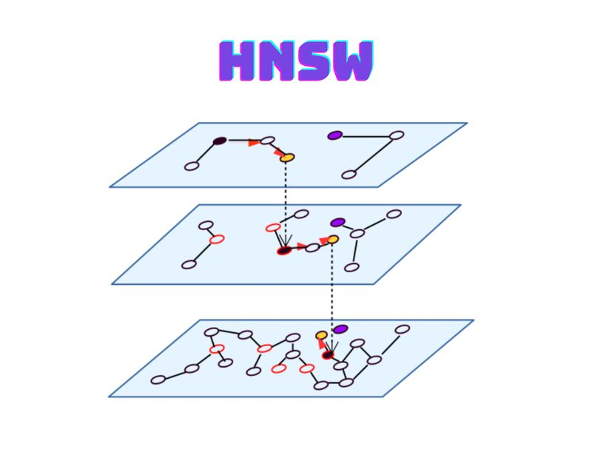
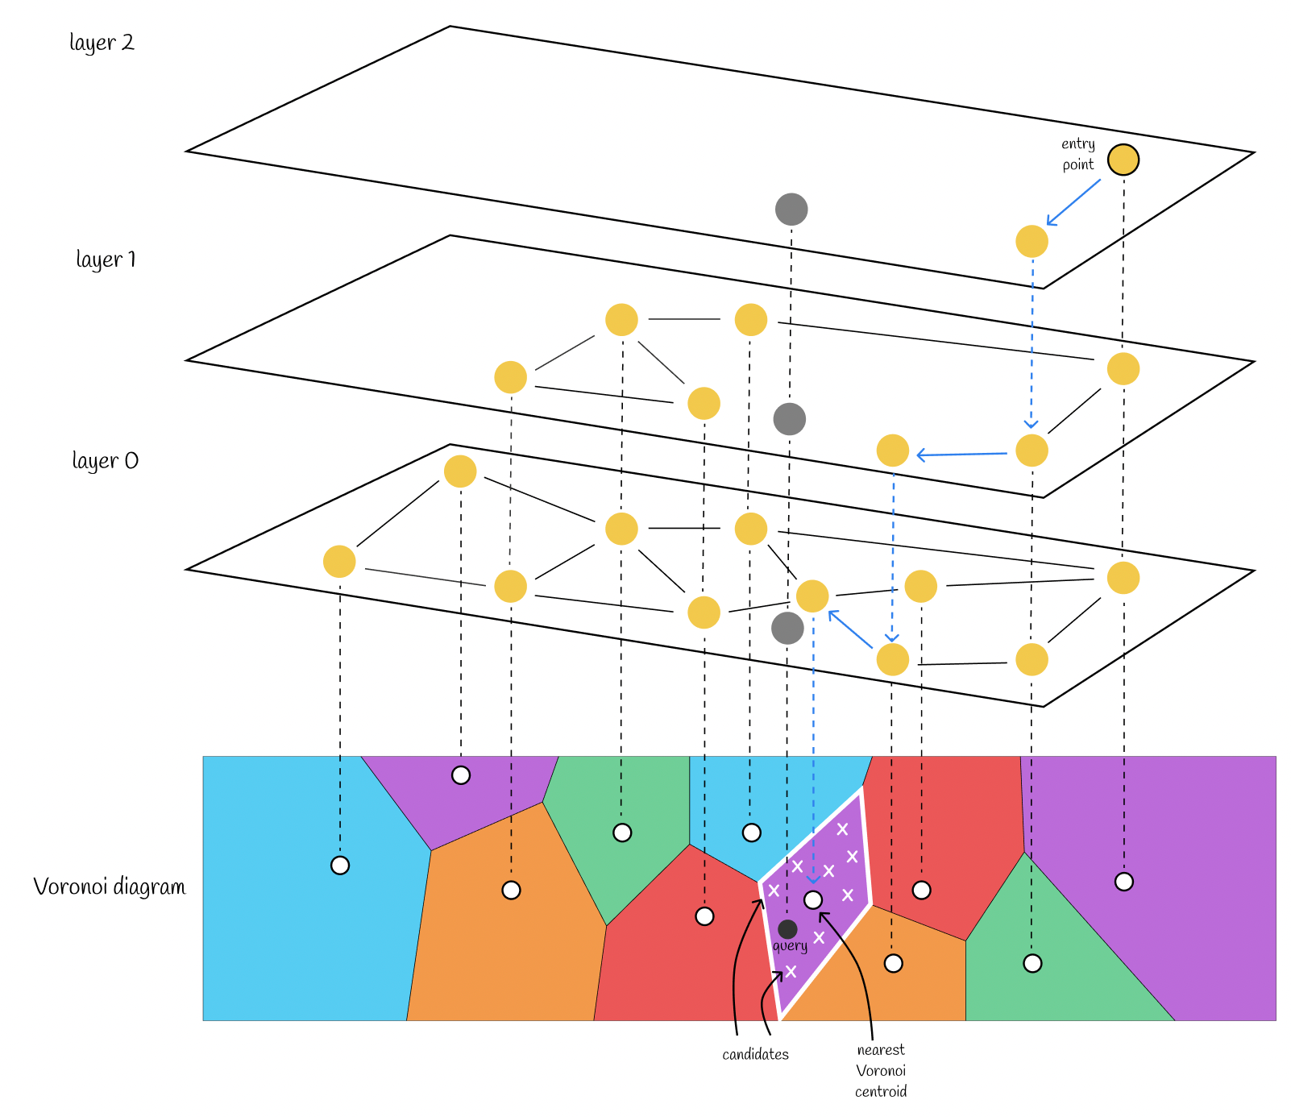
Hierarchical Navigable Small World (HNSW)
Creates a multi-layered graph
Nodes represent vectors
Edges represent connections between similar vectors
Search starts at the top layer and navigates down to find the nearest neighbors.
Excellent performance for high-dimensional data.

Slide 19
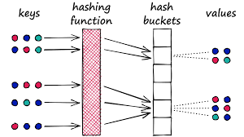
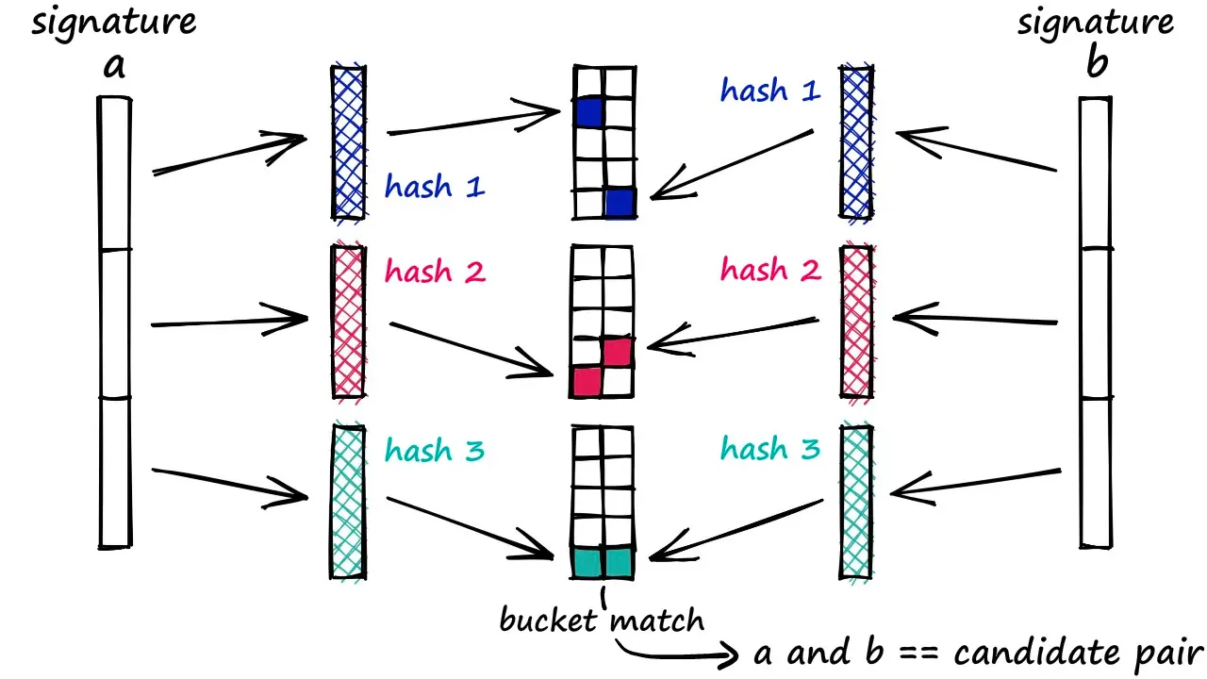
Local Sensitive Hashing (LSH)
Uses hash functions.
Map similar vectors to the same hash buckets with high probability.
Reduces the search space.
Done by only comparing vectors within the same buckets.
Effective for high-dimensional data and large datasets.
Especially when using hamming distance.

Slide 20
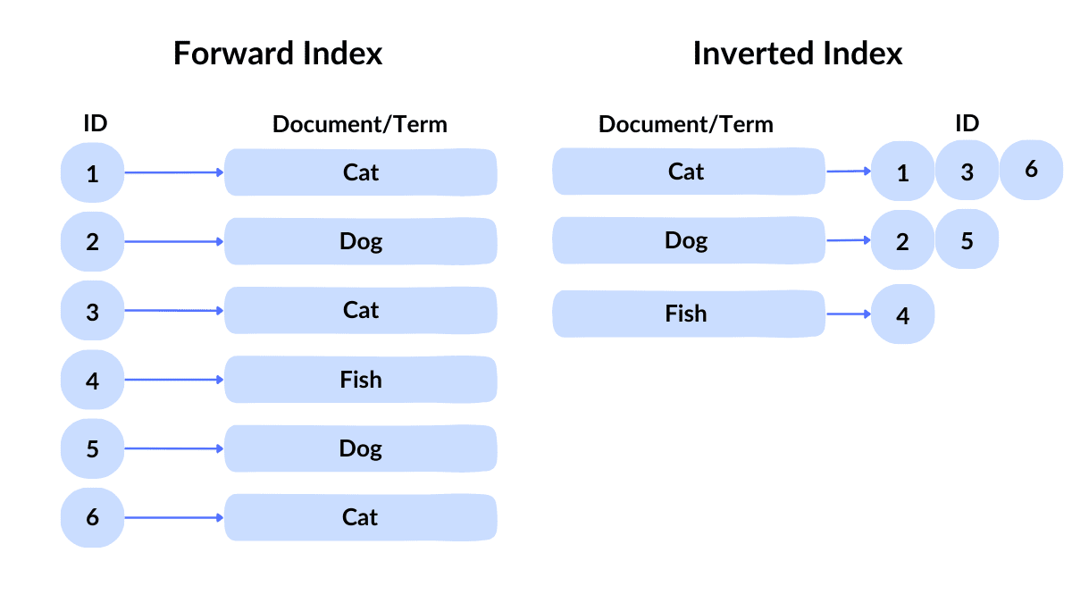
Inverted File System (IVF)
Partitions the vector space into clusters.
During a search,
the query vector is compared to the cluster centroids, and
only the vectors within the closest clusters are examined.
Effective for large datasets.

Slide 21
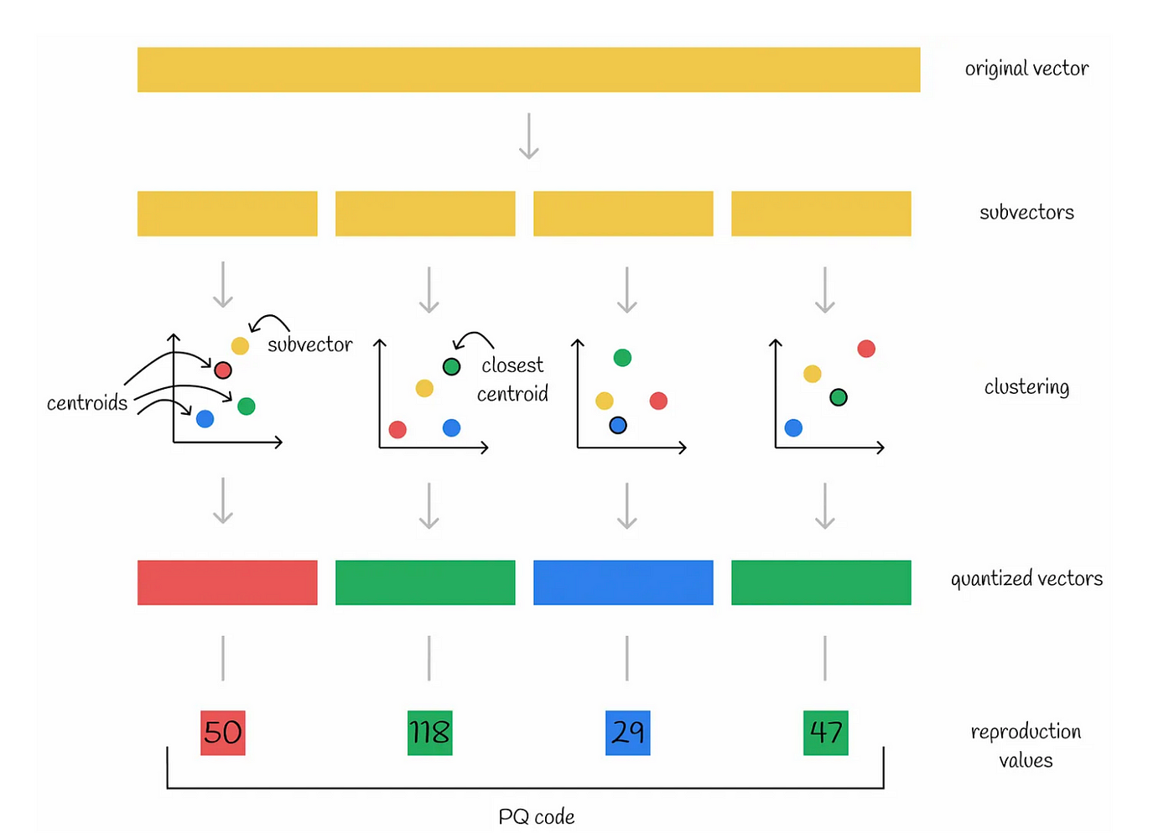
Product Quantization (PQ)
Compresses vectors by
dividing them into sub-vectors
quantizing each sub-vector
Reduces memory usage and speeds up distance calculations.
Suitable for very large datasets.

Slide 22
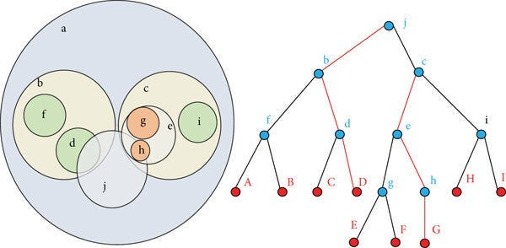
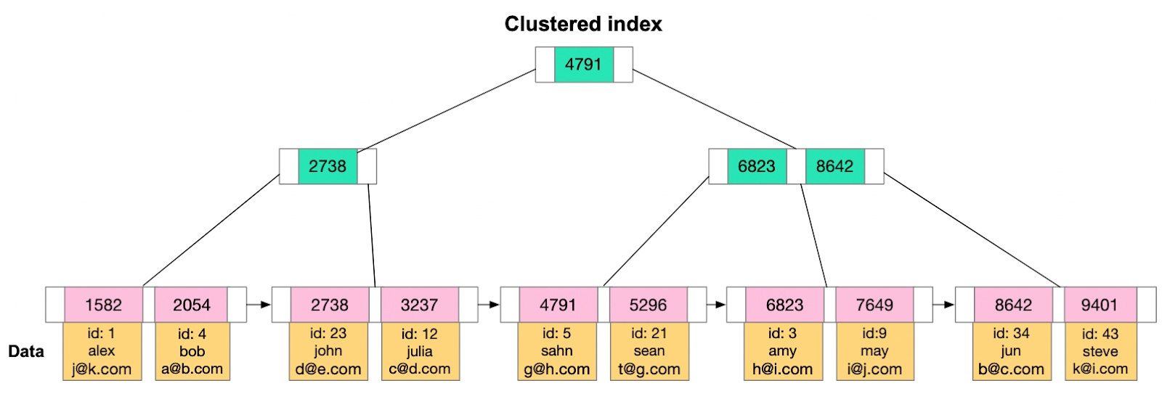
Tree-Based Indexes
Less effective in very high dimensions.
Tree-based indexes can be used for lower-dimensional vector spaces.
Partitions the vector space recursively.
Example: KD-trees

Slide 23
Indexing: Key Considerations
Accuracy vs. Speed:
ANN algorithms provide approximate results, so there's a trade-off between accuracy and search speed.
Dimensionality:
The choice of indexing technique depends on the dimensionality of the vectors. HNSW is generally preferred for high dimensions.
Dataset Size:
Different indexing techniques are optimized for different dataset sizes.
Query Patterns:
The characteristics of your query patterns can influence the choice of indexing.

Slide 24
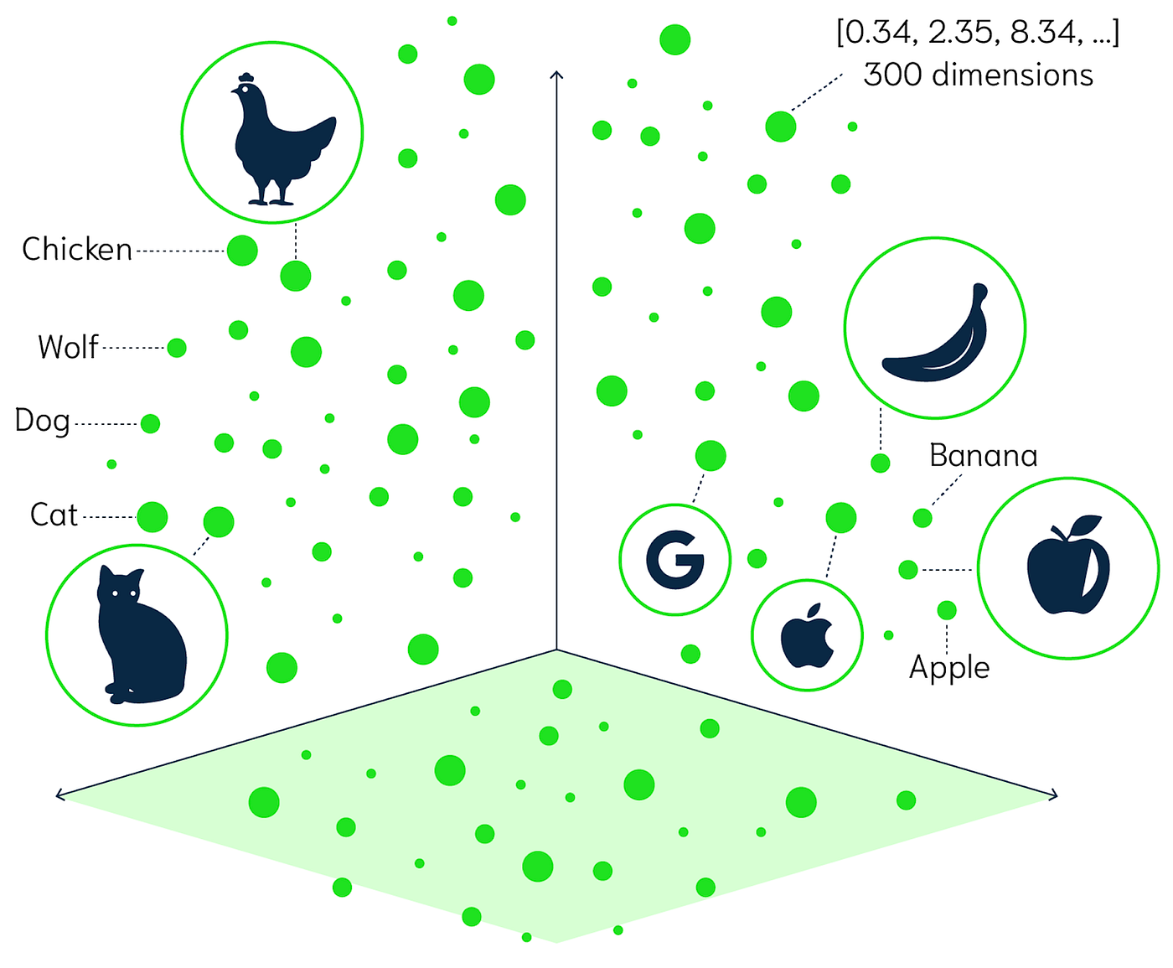
Similarity Search
Also known as nearest neighbor search.
The process of finding data points that are most similar to a given query point.
Involves finding vectors that are closest to a query vector in a high-dimensional space.
Performed in 5 steps.

Slide 25
Similarity Search: Steps
Vector Representation: Data points are represented as vectors in a multi-dimensional space.
Distance Metric: A distance metric is chosen to measure the similarity between vectors.
Query Vector: A query vector is provided, representing the data point for which similar points are to be found.
Nearest Neighbor Search: The database uses indexing techniques (e.g., HNSW, IVF, LSH, PQ) to efficiently identify the vectors closest to the query vector based on the chosen distance metric.
Ranking and Retrieval: The most similar vectors are ranked based on their distance from the query vector and retrieved as the search results.

Slide 26
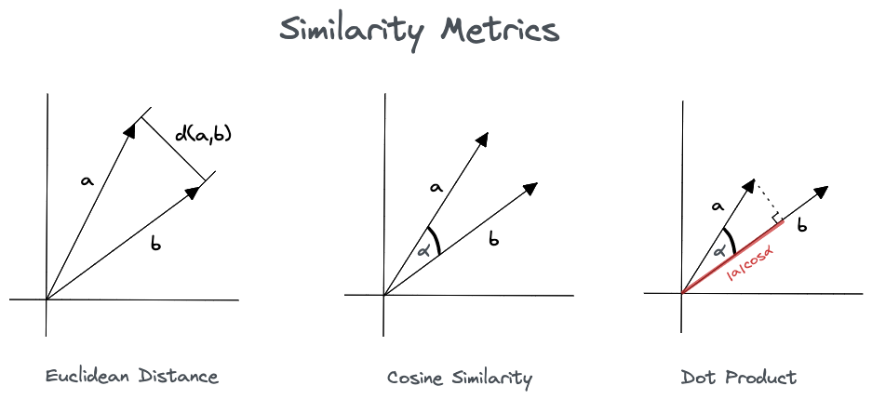
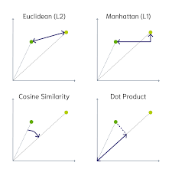
Similarity Search: Distance Metric
Distance Metric: A distance metric is chosen to measure the similarity between vectors.
Euclidean Distance: The straight-line distance between two points.
Cosine Similarity: Measures the angle between two vectors, indicating their orientation similarity.
Dot Product: Measures the projection of one vector onto another.
Hamming Distance: Measures the number of differing bits between two binary vectors.

Slide 27
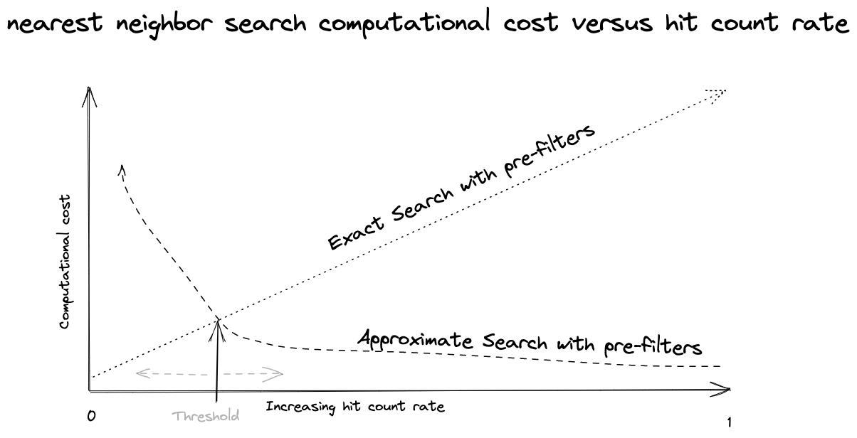
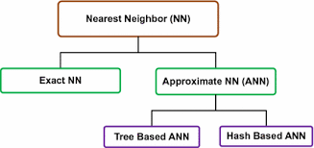
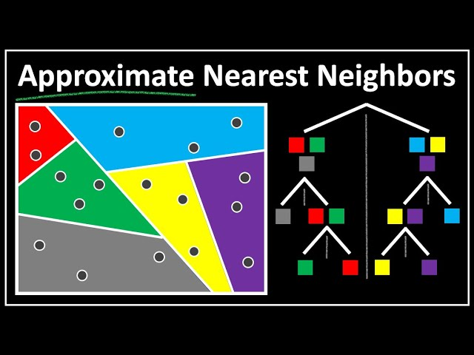
Types of Similarity Search
Exact Nearest Neighbor (ENN):
Finds the absolute nearest neighbors.
Computationally expensive for high-dimensional data and large datasets.
Approximate Nearest Neighbor (ANN):
Trades off a small degree of accuracy for a significant speed improvement.
It finds vectors that are very close to the nearest neighbors,
but not necessarily the absolute closest.
This is the predominant type used in vector databases.

Slide 28
Similarity Search for Different Types of Data
Similarity search fundamentally relies on converting different types of input into vector embeddings.
The process then follows the same general principle of finding nearest neighbors in a vector space.
However, the initial step of generating those embeddings varies significantly depending on the input type.

Slide 29
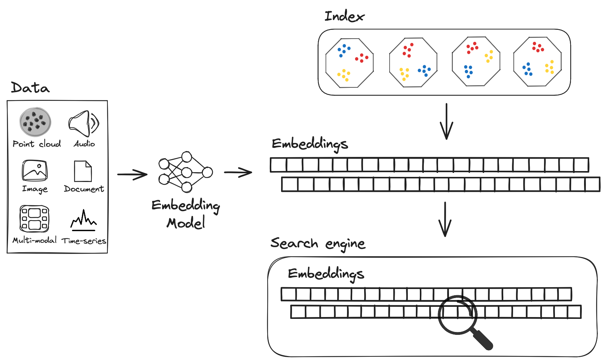
General Workflow
Data Extraction:
The raw input is processed to extract relevant features.
Embedding Generation:
A specialized embedding model is used to convert the extracted features into a vector embedding.
Vector Storage:
The generated vector embeddings are stored in a vector database.
Similarity Search:
When a query is made, the query is converted into a vector embedding, and a similarity search is performed to find the nearest neighbors in the database.

Slide 30
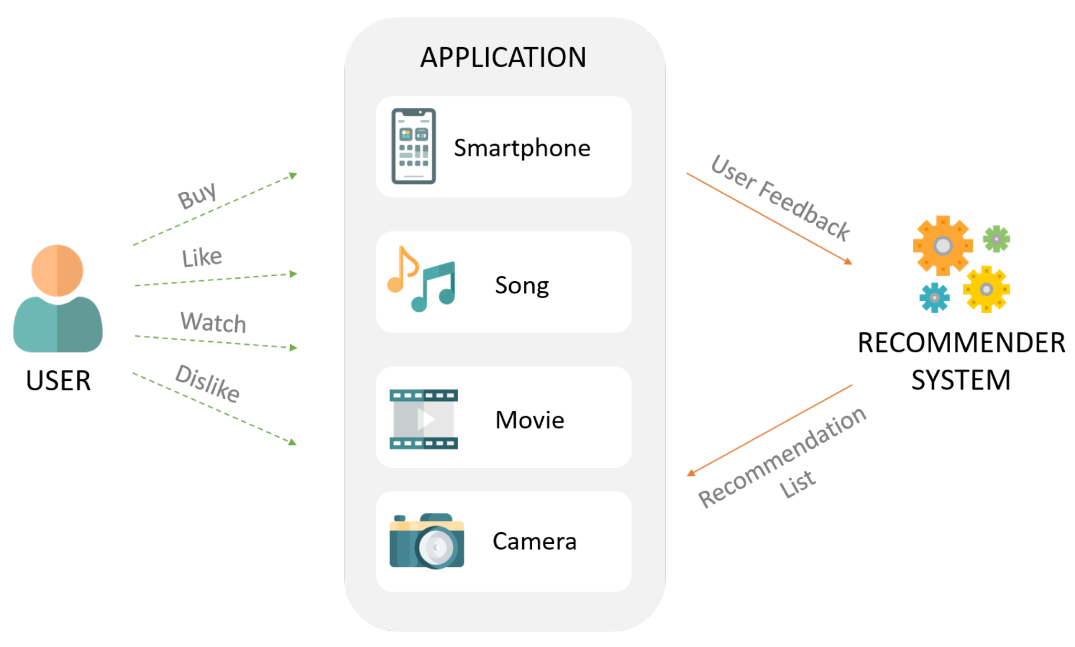
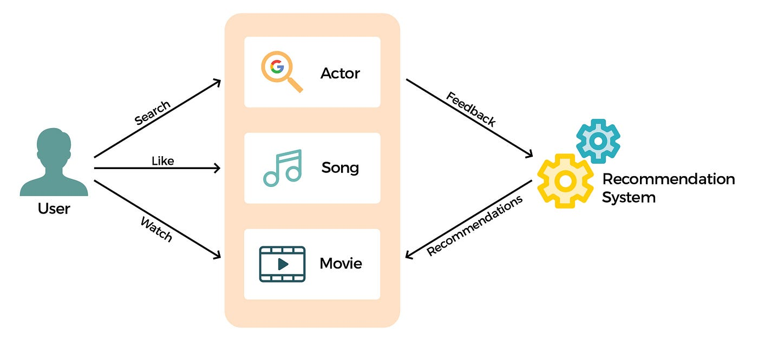
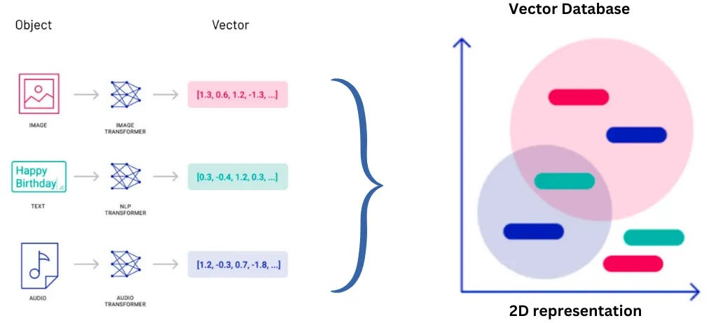
Different Types of Data
Few of the input types are as follows:
Text
Audio
Video
Image
PDF
etc.

Slide 31
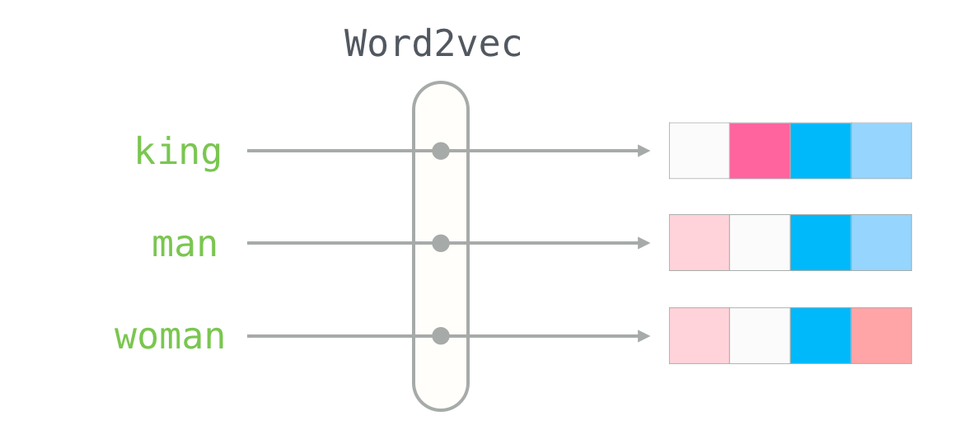
Different Types of Data: Text
Process:
Text is preprocessed (e.g., tokenization, stop-word removal).
A text embedding model (e.g., Sentence Transformers, BERT, Word2Vec) converts the text into a vector embedding.
Similarity search is performed on the resulting vectors.
Examples:
Semantic search, document retrieval, chatbot responses.

Slide 32

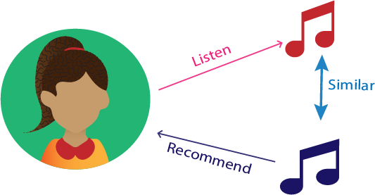
Different Types of Data: Audio
Process:
Audio signals are processed to extract relevant features (e.g., spectrograms, MFCCs).
An audio embedding model (e.g., models trained on audio datasets like AudioSet) converts the features into a vector embedding.
Similarity search is performed on the resulting vectors.
Examples:
Music recommendation, speech recognition, sound event detection.

Slide 33
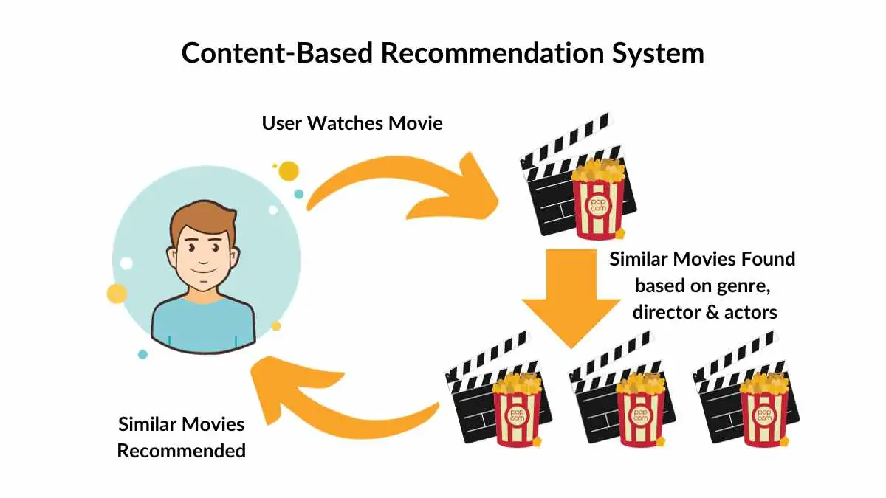
Different Types of Data: Video
Process:
Video is broken down into frames or clips.
Each frame or clip is processed to extract visual and/or audio features.
A video embedding model (e.g., models trained on video datasets like Kinetics) converts the features into a vector embedding.
Similarity search is performed on the resulting vectors.
Examples:
Video recommendation, video content analysis, action recognition.

Slide 34


Different Types of Data: Image
Process:
Image is processed to extract visual features (e.g., using convolutional neural networks (CNNs)).
An image embedding model (e.g., models like CLIP, ResNet) converts the features into a vector embedding.
Similarity search is performed on the resulting vectors.
Examples:
Image retrieval, facial recognition, product search.

Slide 35

Different Types of Data: PDF
Process:
PDF content is extracted (text, images, tables).
Each extracted element is processed according to its type (text, image).
Text is converted to text embeddings, images to image embeddings.
The resulting embeddings can be combined or searched separately.
Often pdfs are broken into chunks, and each chunk is converted into an embedding.
Examples:
Document search, information extraction, legal document analysis.

Slide 36
Different Types of Data: Usage of Distance Metric
In a particular vector database, the choice of distance metric can vary depending on the specific implementation and configuration.
Vector databases offer flexibility in choosing distance metrics.
While a single metric can be used for all data,
different metrics can be used for different data types or indexes.
The embedding model is the biggest influence on which distance metric should be used.
Possible for a database to use the same metric for all data,
and also possible for a database to use different metrics for different sets of data. It is up to the user to decide.

Slide 37
Usage of Single Distance Metric
A single distance metric can be used for all types of data within a single index:
This is common for simplicity and efficiency.
If your embeddings are all in the same vector space, it simplifies the query process.
For example, if you're using cosine similarity,
that metric can be applied to all the vector embeddings regardless of whether they represent text, images, or audio.

Slide 38
Usage of Multiple Distance Metrics
Vector databases often allow you to specify different distance metrics for different indexes or collections:
This provides flexibility to optimize for different types of data and embedding models.
Also, some databases allow the user to define their own distance metric.
For instance, you might use cosine similarity for text embeddings and Euclidean distance for image embeddings.

Slide 39
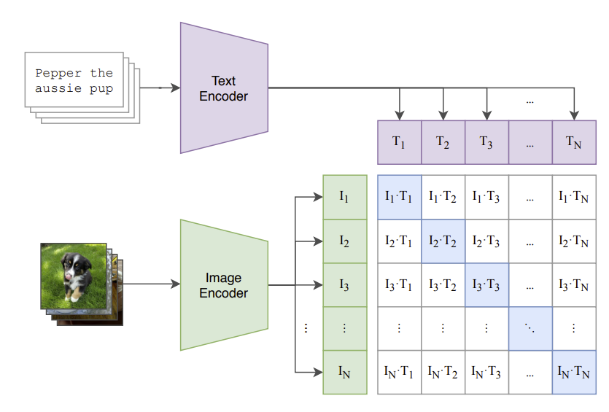
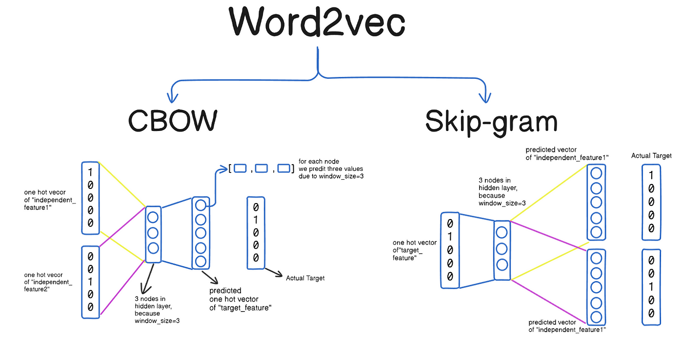
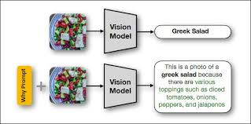
Underlying Embedding Model Influence
The embedding model itself often dictates the most appropriate distance metric.
For example,
some models are designed to work best with cosine similarity
Sentence Transformers
CLIP(Contrastive Language–Image Pre-training)
while others are better suited for Euclidean distance
Word2Vec
Skip-gram
CBOW(Continuous Bag-of-Words)
So, even if a vector database allows you to use any metric,
the optimal choice is often determined by the embedding model.

Slide 40
Advantages of Vector Databases
purpose-built for finding the closest matches to a given vector
handle the ever-growing volume of data generated
Optimized for vector data, leading to more efficient resource utilization
Support for diverse data types beyond just vectors
Fast Similarity Search(Speed)
Performance
Cost-Effectiveness
Flexibility
Scalability
Ease of Use
Customization
scale horizontally to accommodate massive datasets and high query volumes
User-friendly APIs and SDKs simplify integration
choosing different distance metrics and configuring indexing parameters to fine-tune performance etc.

Slide 41
OPEN SOURCE
DATABASES

Slide 42
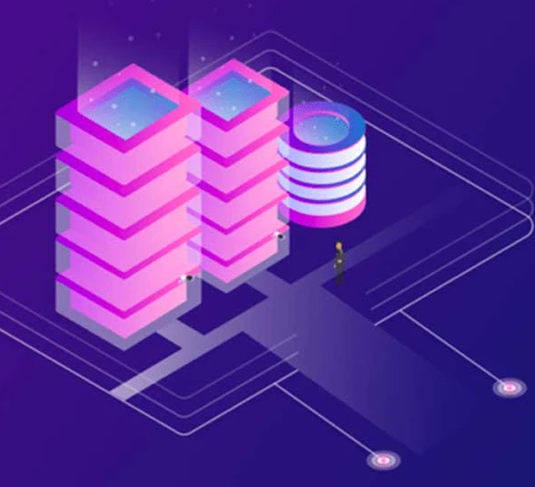
Open Source Database
Database management systems (DBMS).
Source code is publicly available and can be freely:
used,
modified, and
distributed.
Offer a powerful and cost-effective solution for many data management needs.
Popular Examples:
Relational Databases: MySQL, PostgreSQL, MariaDB
NoSQL Databases: MongoDB, Cassandra, Redis, CouchDB, Neo4j

Slide 43
Examples of Open Source Databases
Faiss (Facebook AI Similarity Search)
Chroma
efficient similarity search,
clustering of dense vectors
AI-native,
simplifies the development of LLM applications
Milvus
Qdrant
high-performance,
efficient similarity search,
AI applications
fast, scalable, and
vector similarity search engine

Slide 44
INFORMATION
RETRIEVAL

Slide 45
Information Retrieval
The science of finding and retrieving relevant information from within a collection of documents.
This could be anything from
a single file to the entire internet.

Slide 46
Information Retrieval Steps
Retrieval
Documents matching the query are retrieved from the index.
Query Processing
User queries are analyzed and transformed for efficient indexing search.
Indexing
User Interface
Documents are processed to create an index for fast searching.
Search results are presented to the user in a user-friendly format.
Ranking
Retrieved documents are ranked by relevance to the query.

Slide 47
Role of DB in Information Retrieval
Traditional DB
Vector DB
Can be used to store and retrieve structured information.
Related to documents, such as:
author,
publication date, and
metadata.
Not typically designed for efficient searching of full-text documents.
Revolutionized information retrieval by enabling:
Semantic Search:
Finding information based on meaning and context, not just keywords.
Personalized Search:
Delivering search results tailored to individual user preferences.
Multimedia Search:
Searching for images, videos, and audio based on visual or acoustic similarity.

Slide 48
NoSQL

Slide 49
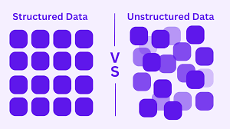

Structured vs. Unstructured Data

Slide 50
Key Characteristics
Schema-less or Flexible Schemas
Handling Unstructured Data
No strict table definitions, allowing for dynamic data structures
Effectively manage data like social media posts, sensor data, and user-generated content.
Scalability
Agility and Flexibility
Designed to scale horizontally (adding more servers) easily.
Adapt quickly to changing data requirements and business needs.
High Availability
Data Distribution
Minimize downtime and ensure continuous operation.
Often distributed across multiple servers for improved performance and fault tolerance.
NoSQL
Not Only SQL - broad category of databases
don't adhere to the traditional relational database model (RDBMS).
Focus on Flexibility - Designed to handle diverse data structures

Slide 51
Key Concepts in NoSQL
CAP Theorem
Schema-less vs. Schemaless
Data Distribution
Consistency: All nodes see the same data at the same time.
Availability: The system is always available to handle requests.
Partition Tolerance: The system can continue to operate even if parts of it are partitioned.
Schema-less: No predefined structure, allows for dynamic data.
Schemaless: More flexible than traditional schemas, but often has some basic constraints.
Sharding: Distributing data across multiple servers based on a partitioning key.
Replication: Creating copies of data on multiple servers for fault tolerance and improved read performance.

Slide 52
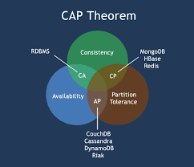
CAP Theorem
Consistency:
All nodes see the same data at the same time.
Availability:
The system is always available to handle requests.
Partition Tolerance:
The system can continue to operate even if parts of it are partitioned.

Slide 53
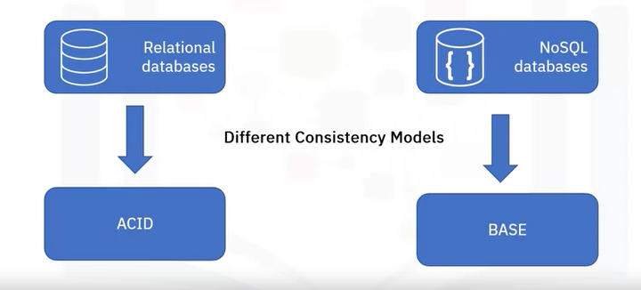
BASE
Basically Available: System responds, but data may not be current.
guarantees availability of the data
will respond to requests
data returned might not be the most up-to-date
prioritizes responsiveness over strict consistency
Soft State: Data changes over time, not always immediately consistent.
state of the system can change over time, even without input
data may not be immediately consistent across all nodes
system relies on eventual consistency
Eventually Consistent: Data will become consistent given time and no new updates.
if no new updates are made to the data,
eventually, all accesses to that data will return the last updated value
there may be a delay between updates and visibility
trade-off between consistency and availability

Slide 54
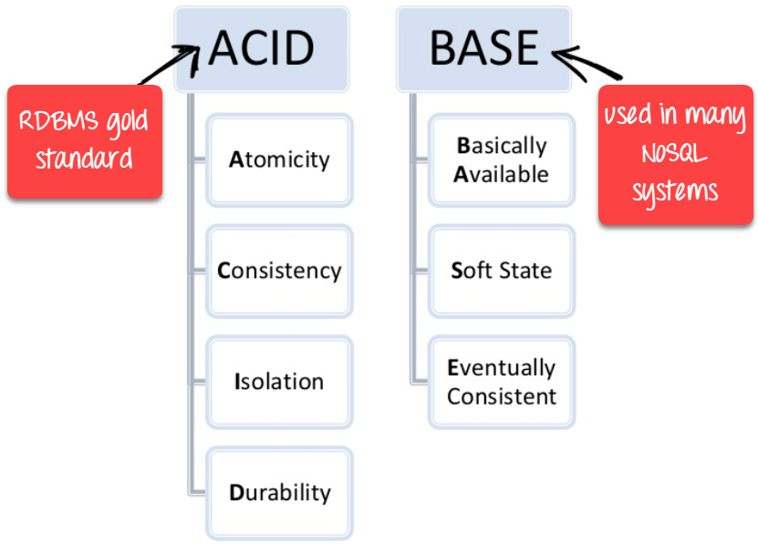
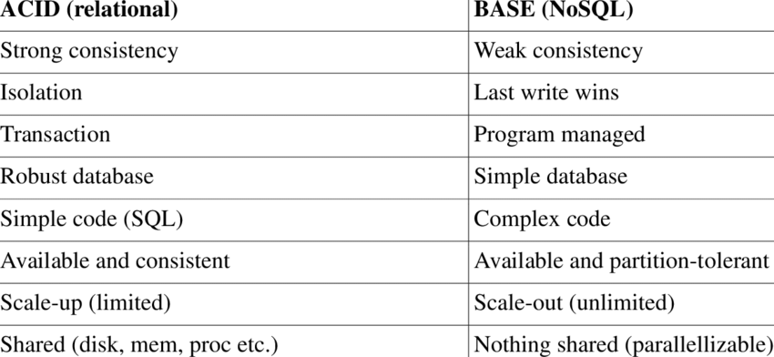
ACID vs. BASE

Slide 55
Why BASE?
Scalability:
allow NoSQL databases to scale horizontally more easily
Performance:
relaxes consistency requirements
NoSQL databases can achieve higher performance
Flexibility:
BASE is well-suited for applications that don't require strict consistency
ex: social media, e-commerce, and content management systems

Slide 56
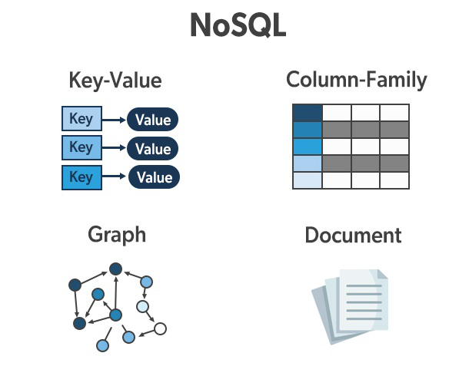
Types of NoSQL Databases
Key-Value Stores
Column-Family Databases
Simple data mode
Use Cases: Caching, session management, storing user preferences.
Redis, Memcached, Amazon DynamoDB
Store data in columns, optimized for high write throughput.
Use Cases: Time-series data, log analysis, social media feeds.
Cassandra, HBase
Document Databases
Graph Databases
Store data in flexible, document-like structures (e.g., JSON, XML).
Use Cases: Content management systems, e-commerce platforms, storing user profiles
MongoDB, Couchbase, DocumentDB.
Represent data as nodes and relationships between them.
Use Cases: Social networks, recommendation systems, fraud detection.
Neo4j, JanusGraph

Slide 57
Advantages and Disadvantages
Flexibility
Cost
Effectiveness
Performance
NoSQL
Limited SQL Support
Data Modeling Complexity
Limited ACID Properties

Slide 58
MongoDB

Slide 59

MongoDB: Fueling Generative AI through Intelligent Information Retrieval
1. Generative AI Relies on Data – The ability to create text, images, and music depends on vast datasets and efficient information retrieval.
2. MongoDB’s Strength in Flexibility & Power – MongoDB provides a powerful and flexible database solution tailored to generative AI’s unique demands.
3. Enhancing Information Retrieval – MongoDB enables efficient data access, supporting generative AI models in crafting novel content effectively.
Generative AI's reliance on data is paramount. MongoDB provides the infrastructure for managing and retrieving this crucial information.

Slide 60

The Data Landscape of Generative AI - Diverse and Dynamic
Unstructured data
Text, images, audio, and video in their raw formats.
Structured data
Metadata, tags, labels, and annotations providing context.
MongoDB
Embeddings
Vector representations capturing semantic meaning, crucial for understanding relationships.
Model Outputs
Storing generated content for analysis, refinement, and future training.
MongoDB's flexible schema effortlessly accommodates this heterogeneity, eliminating the rigidity of traditional relational databases.

Slide 61
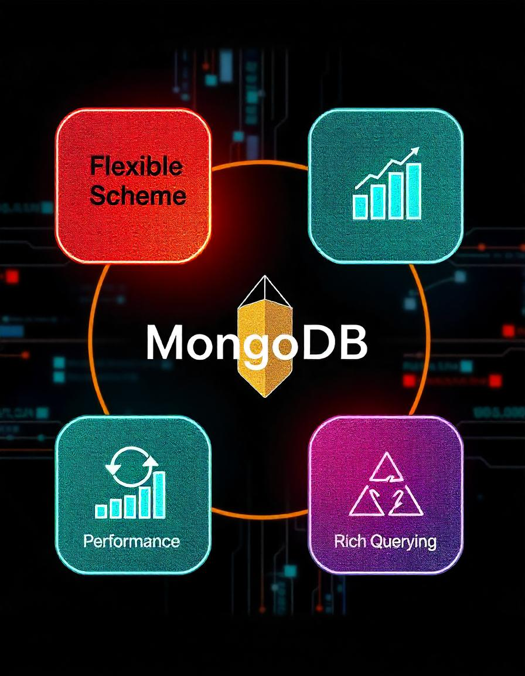
MongoDB's Strengths for Generative AI - Designed for the Task
Scalability
Flexible Schema
Handle massive datasets with horizontal scaling, crucial for training complex generative models.
Store and manage diverse data without predefined structures, adapting to evolving data requirements.
01
02
03
04
Performance
Rich Querying
Optimized query engine and indexing for fast retrieval, essential for real-time applications and efficient training.
Powerful operators for filtering, aggregation, text search, and geospatial queries for extracting specific information.

Slide 62
Role of MongoDB in Generative AI Information Retrieval
Storing the data
Real-time Data Processing
Enables streaming updates for AI fine-tuning.Supports caching frequently accessed data.
Stores raw text, images, embeddings, and metadata.Example: Large-scale datasets for training LLMs.
Vector Search for Similarity Matching
Hybrid Search (Text + Vector Search)
Stores and searches vector embeddings efficiently.Used for context-based retrieval in chatbots.
Combines full-text search with vector embeddings.Enhances search accuracy in AI responses.

Slide 63
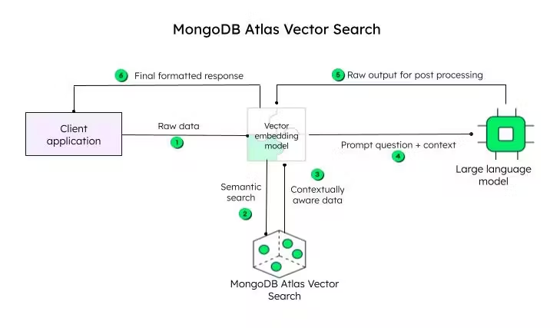
Working of MongoDB in Generative AI Information Retrieval

Slide 64

Working Overview - How it Works
1. Raw Data Ingestion: Data from your application is sent to the vector embedding model.
2. Vector Embedding Model: This model (e.g., OpenAI, Cohere) transforms the raw data into vector representations.
3. Semantic Search: Queries are also converted into vectors and compared to the data vectors in MongoDB Atlas. Results are returned based on semantic similarity.
4. Prompt + Context (Optional): For LLM integration, the original query and relevant context from the vector search are sent to the LLM.

Slide 65

Working Overview - How it Works
5. Large Language Model (LLM): The LLM generates a natural language response based on the context and prompt.
6. Final Formatted Response: The response is sent back to the user application.
7. MongoDB Atlas Vector Search: Stores and indexes the vector embeddings, enabling efficient similarity searches.
8. Raw Output for Post-Processing (Optional): The raw LLM output can be accessed for further processing or analysis.

Slide 66
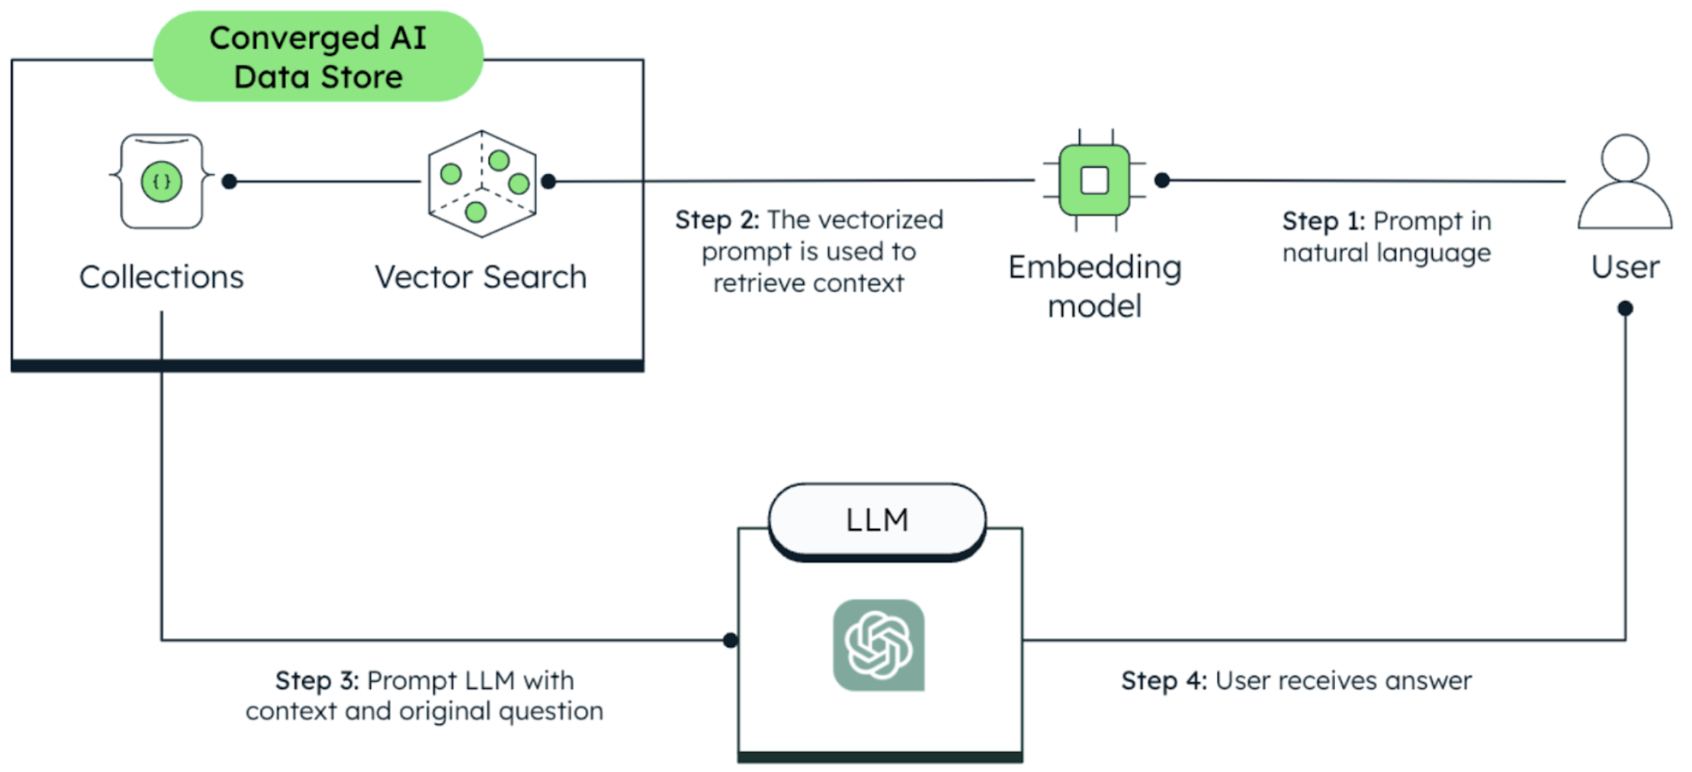
Architecture of a Generative AI System with MongoDB

Slide 67

LLM
Prompt:
Input text that instructs an LLM to generate a response.
LLM:
AI model trained on massive text data for language understanding and generation.
type of artificial intelligence (AI) model
uses deep learning techniques
ability to understand, generate, and manipulate human language
Types of LLM:
Encoder-Only
Decoder-Only
Encoder-Decoder
Multimodal

Slide 68



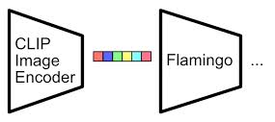
Types of LLMs
Decoder-Only:
Generates text sequentially (GPT).
Best for creative writing and chatbots.
Encoder-Only:
Understands context (BERT).
Best for classification and analysis.
Encoder-Decoder:
Handles diverse tasks (T5, BART).
Best for translation and summarization.
Multimodal:
Processes multiple data types (CLIP, Flamingo).
Best for cross-modal understanding (images & text).

Slide 69
Architecture of a Generative AI System with MongoDB
1. Data Ingestion Layer
Collects data from various sources.Stores structured and unstructured data in MongoDB.
2. Embedding Generation
Uses AI models (OpenAI, BERT) to create vector representations.
3. Storage & Indexing
Stores raw text and embeddings in MongoDB collections.Uses indexes for faster retrieval.
4. Information Retrieval Process
Query → Vector Search → Ranking → AI Response Generation.
5. AI Model Integration
Uses MongoDB results to generate AI responses.

Slide 70
Use Cases of MongoDB in Generative AI
01
AI Chatbots & Virtual Assistants
Uses vector search to retrieve relevant responses.
02
Enterprise Search Engines
Finds information across large corporate databases.
03
AI-Powered Recommendations
Provides personalized suggestions (e.g., movies, products).
04
Retrieves relevant code snippets for AI-assisted coding.
Code Generation & Documentation

Slide 71

Challenges & Solutions
Challenge | Solution (in MongoDB)
Large Dataset Size | Sharding for horizontal scaling
Fast Query Execution | Uses indexing and vector search
AI Model Integration | Native support for embeddings
Data Consistency | Replication ensures reliability

Slide 72

Summary
MongoDB is an essential database for generative AI applications.
Provides efficient storage, indexing, and retrieval of AI-relevant data.
Supports vector search, full-text search, and real-time processing.
Ideal for AI-powered search engines, chatbots, and recommendation systems.

Slide 73
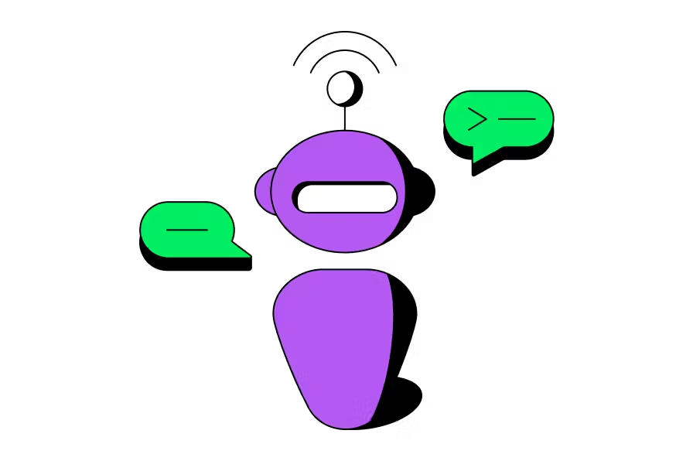
MongoDB Atlas Vector Search
What it is:
Finds similar data using vectors within MongoDB Atlas.
How it works:
Store vectors: Embed your data (text, images, etc.) as vectors.
Create indexes: Build specialized indexes for fast vector searches.
Search: Find the most similar data points using the $vectorSearch command.
Key takeaways:
Enables semantic search within MongoDB Atlas.
Goes beyond keyword searches to find truly similar data.

Slide 74

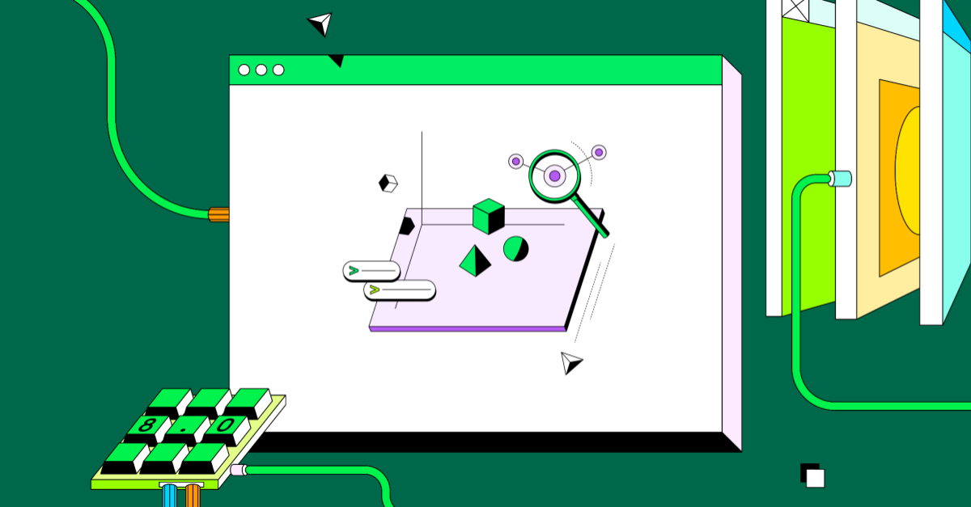
JSON
JSON (JavaScript Object Notation)
lightweight, text-based data interchange format
used to transmit data between a server and a web application, or between any two applications
originated from JavaScript, JSON is language-independent
data is organized into key-value pairs, similar to dictionaries
uses a simple and consistent syntax
Example: JSON { "_id": ObjectId("6479d65835b73667074b2345"),
"name": "John Doe",
"age": 30,
"city": "New York" }

Slide 75
MongoDB Syntax: Core Concepts
Basic Structure:
Documents: MongoDB stores data in flexible, JSON-like documents.
Example: JSON { "_id": ObjectId("6479d65835b73667074b2345"),
"name": "John Doe",
"age": 30,
"city": "New York" }
Collections: Documents are grouped together within collections, analogous to tables in relational databases.
Databases: Collections are organized within databases.

Slide 76
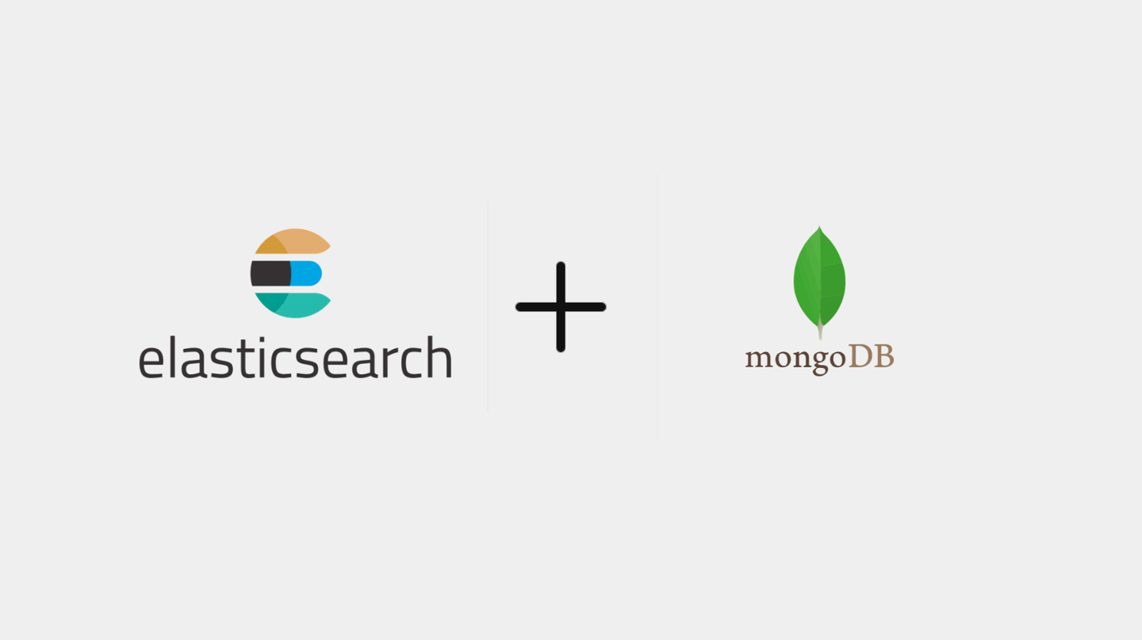
MongoDB vs. ElasticSearch: JSON Usage
MongoDB: General-purpose document database. Uses JSON as its storage format. Optimized for application data storage and retrieval. Strong for transactions. Good for general purpose data storage. | Elasticsearch: Distributed search and analytics engine. Uses JSON for data input, output, and configuration. Optimized for full-text search and real-time analytics. Excellent for log analysis and search.
Key Difference:
MongoDB: Data storage and manipulation.
Elasticsearch: Data indexing and search.
Best Use:
"better" or “best” depends entirely on specific needs
Use MongoDB for application data.
Use Elasticsearch for advanced search and analytics.
They are often used together.

Slide 77
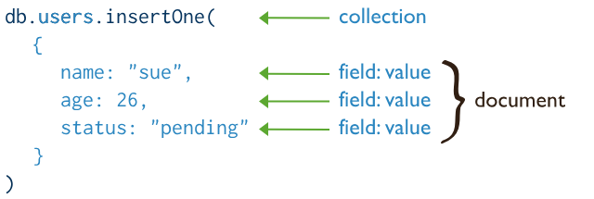
MongoDB Syntax: Core Concepts
CRUD Operations:
Create: insertOne(), insertMany()
Read: find(), findOne()
Update: updateOne(), updateMany()
Delete: deleteOne(), deleteMany()
Query Operators:
Comparison Operators: $eq, $gt, $gte, $lt, $lte, $ne
Logical Operators: $and, $or, $not
Array Operators: $in, $nin, $all, $size
Element Operators: $exists, $type
Projection: Specify which fields to include or exclude in the result ({ field1: 1, field2: 0 })
Aggregation Framework:
A powerful tool for data processing and analysis.
Uses a pipeline of stages (e.g., $match, $group, $project, $sort) to transform and summarize data.

Slide 78



MongoDB: CRUD Operations
CRUD Operations
CRUD Operations:
Create: insertOne(), insertMany()
Read: find(), findOne()
Update: updateOne(), updateMany()
Delete: deleteOne(), deleteMany()

Slide 79


MongoDB: Query Operations
Query Operators:
Comparison Operators: $eq, $gt, $gte, $lt, $lte, $ne
Logical Operators: $and, $or, $not
Array Operators: $in, $nin, $all, $size
Element Operators: $exists, $type
Projection: Specify which fields to include or exclude in the result ({ field1: 1, field2: 0 })

Slide 80


MongoDB: Aggregation
Aggregation Framework:
A powerful tool for data processing and analysis.
Uses a pipeline of stages (e.g., $match, $group, $project, $sort) to transform and summarize data.

Slide 81
Advantages of MongoDB
Flexibility
Productivity
Scalability
Schema-less Design
Dynamic Schema Updates
Document-Oriented Model
Rich Query Language
Horizontal Scaling (Sharding)
High Availability

Slide 82
COMPARISONS & CONCLUSION

Slide 83
Vector Databases vs. MongoDB: A Comparison
Feature
Vector DB
MongoDB
Primary Focus | Vector Search | General Purpose Document Storage
Query Type | Similarity Search | Document Matching/Aggregation
Performance | Optimized for Vector Search | Requires Custom Indexing/Queries
Scalability | Designed for Vector Data | Scalable for various data types
Data Model | Vector Embeddings | Documents (including arrays)
Use Cases | AI applications, semantic search, recommendation systems | General purpose applications, including some AI use cases

Slide 84



Slide 85


CONCLUSION
Vector Databases:
Power AI with similarity search.
Open Source Options:
Faiss, Milvus, Chroma offer flexibility and cost-effectiveness.
MongoDB Atlas Vector Search:
Integrates seamlessly for efficient AI within MongoDB.
Future:
Vector databases are crucial for the future of AI-powered applications.

Slide 86

THANK
YOU!

